Slide 1
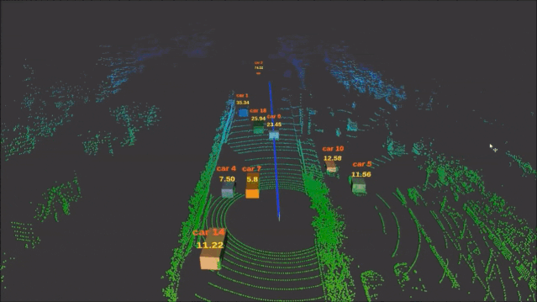


DOA Estimation
& Passive Radar
Background，Algorithms，Calculation，Detail，Conclusion
Wei Xinyuan，Zhang Yiyang
Notes:
大家好，我们本次报告的主体是软体机器人

Slide 2
Contents
01
DOA Tech Background
02
DOA Algorithms
Range-Doppler Calculation
03
04
Experience Detail
05
Conclusion
Notes:
四个部分

Slide 3
First
DOA Tech Background

Slide 4


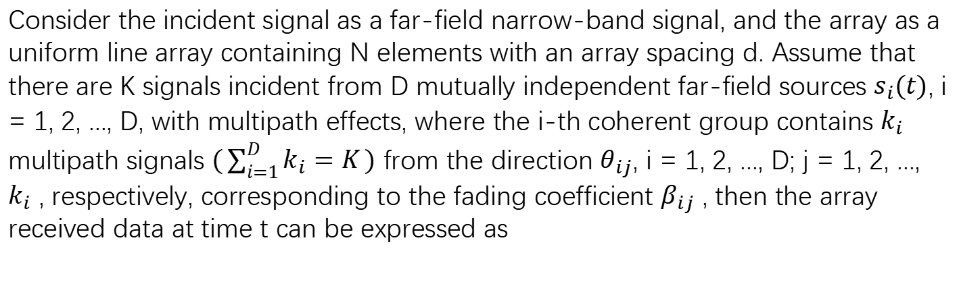
DOA Tech Background
Consider the incident signal as a far-field narrow-band signal, and the array as a uniform line array containing N elements with an array spacing d. Assume that there are K signals incident from D mutually independent far-field sources $s_{i}(t)$, i = 1, 2, ..., D, with multipath effects, where the i-th coherent group contains $k_{i}$ multipath signals $(\sum_{i=1}^{D}{k_{i}=K})$ from the direction $θ_{ij}$, i = 1, 2, ..., D; j = 1, 2, ..., $k_{i}$ , respectively, corresponding to the fading coefficient $β_{ij}$ , then the array received data at time t can be expressed as

Slide 5
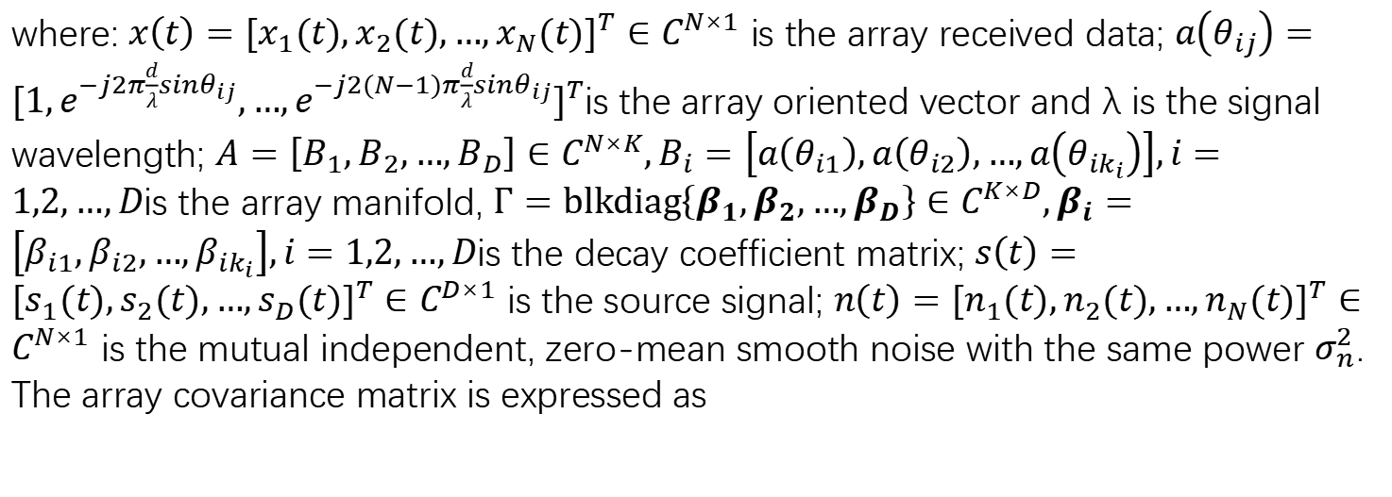
DOA Tech Background
where: $x\left(t\right)={[x_{1}(t),x_{2}(t),…,x_{N}(t)]}^{T}∈C^{N×1}$ is the array received data; $a\left(θ_{ij}\right)={[1,e^{−j2π\frac{d}{λ}sinθ_{ij}},…,e^{−j2(N−1)π\frac{d}{λ}sinθ_{ij}}]}^{T}$is the array oriented vector and λ is the signal wavelength; $A=\left[B_{1},B_{2},…,B_{D}\right]∈C^{N×K},B_{i}=\left[a\left(θ_{i1}\right),a\left(θ_{i2}\right),…,a\left(θ_{ik_{i}}\right)\right],i=1,2,…,D$is the array manifold, $Γ=blkdiag\left\{β_{1},β_{2},{…,β}_{D}\right\}∈C^{K×D},β_{i}=\left[β_{i1},β_{i2},…,β_{ik_{i}}\right],i=1,2,…,D$is the decay coefficient matrix; $s\left(t\right)={[s_{1}(t),s_{2}(t),…,s_{D}(t)]}^{T}∈C^{D×1}$ is the source signal; $n\left(t\right)={[n_{1}(t),n_{2}(t),…,n_{N}(t)]}^{T}∈C^{N×1}$ is the mutual independent, zero-mean smooth noise with the same power $σ_{n}^{2}$. The array covariance matrix is expressed as

Slide 6
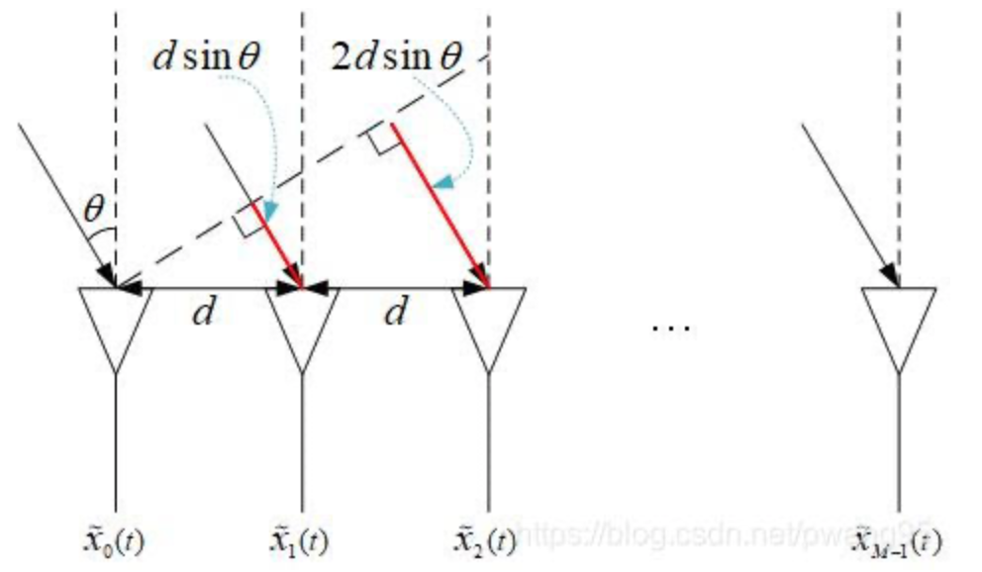
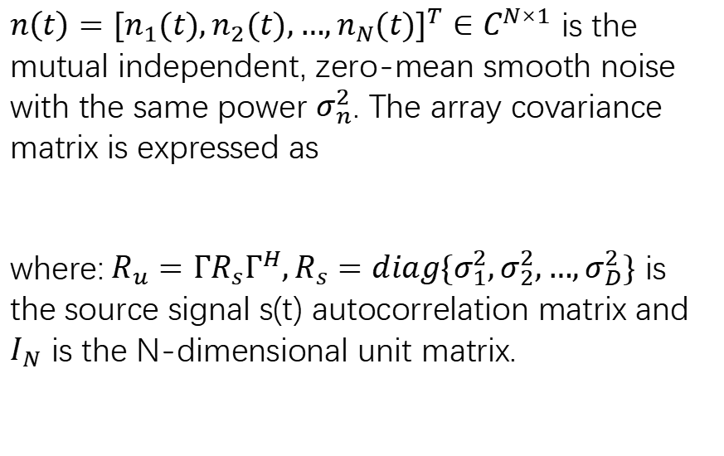
DOA Tech Background
$n\left(t\right)={[n_{1}(t),n_{2}(t),…,n_{N}(t)]}^{T}∈C^{N×1}$ is the mutual independent, zero-mean smooth noise with the same power $σ_{n}^{2}$. The array covariance matrix is expressed as
where:$R_{u}=ΓR_{s}Γ^{H},R_{s}=diag\{σ_{1}^{2},σ_{2}^{2},…,σ_{D}^{2}\}$ is the source signal s(t) autocorrelation matrix and $I_{N}$ is the N-dimensional unit matrix.

Slide 7
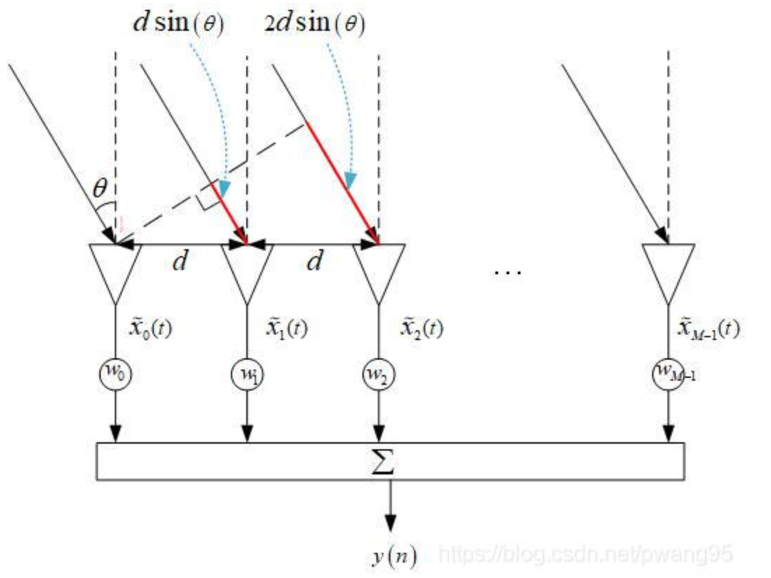
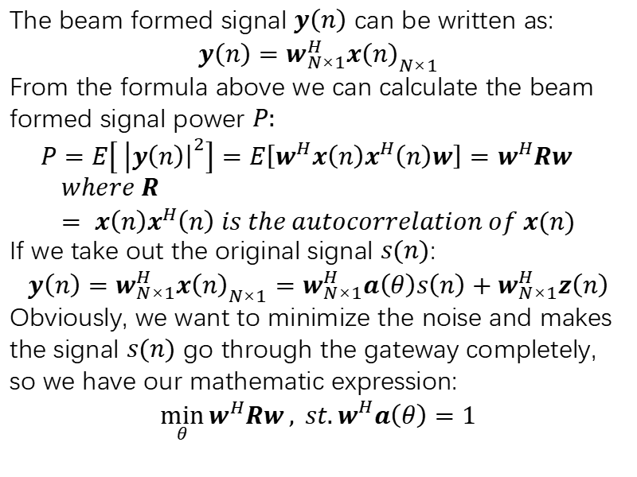
DOA Tech Background
MVDR(Minimum Variance Distortionless Response)
The beam formed signal $y\left(n\right)$ can be written as:
$$y\left(n\right)=w_{N×1}^{H}x{\left(n\right)}_{N×1}$$
From the formula above we can calculate the beam formed signal power $P:$
$$P=E\left[ | {\left.​y\left(n\right)\right|}^{2}\right]=E\left[w^{H}x\left(n\right)x^{H}\left(n\right)w\right]=w^{H}Rw$$
$$where R= x\left(n\right)x^{H}\left(n\right) is the autocorrelation of x(n)$$
If we take out the original signal $s(n)$:
$$y\left(n\right)=w_{N×1}^{H}x{\left(n\right)}_{N×1}=w_{N×1}^{H}a\left(θ\right)s\left(n\right)+w_{N×1}^{H}z\left(n\right)$$
Obviously, we want to minimize the noise and makes the signal $s(n)$ go through the gateway completely, so we have our mathematic expression:
$$\min_{θ}{w^{H}Rw}, st.w_{ }^{H}a\left(θ\right)=1$$

Slide 8
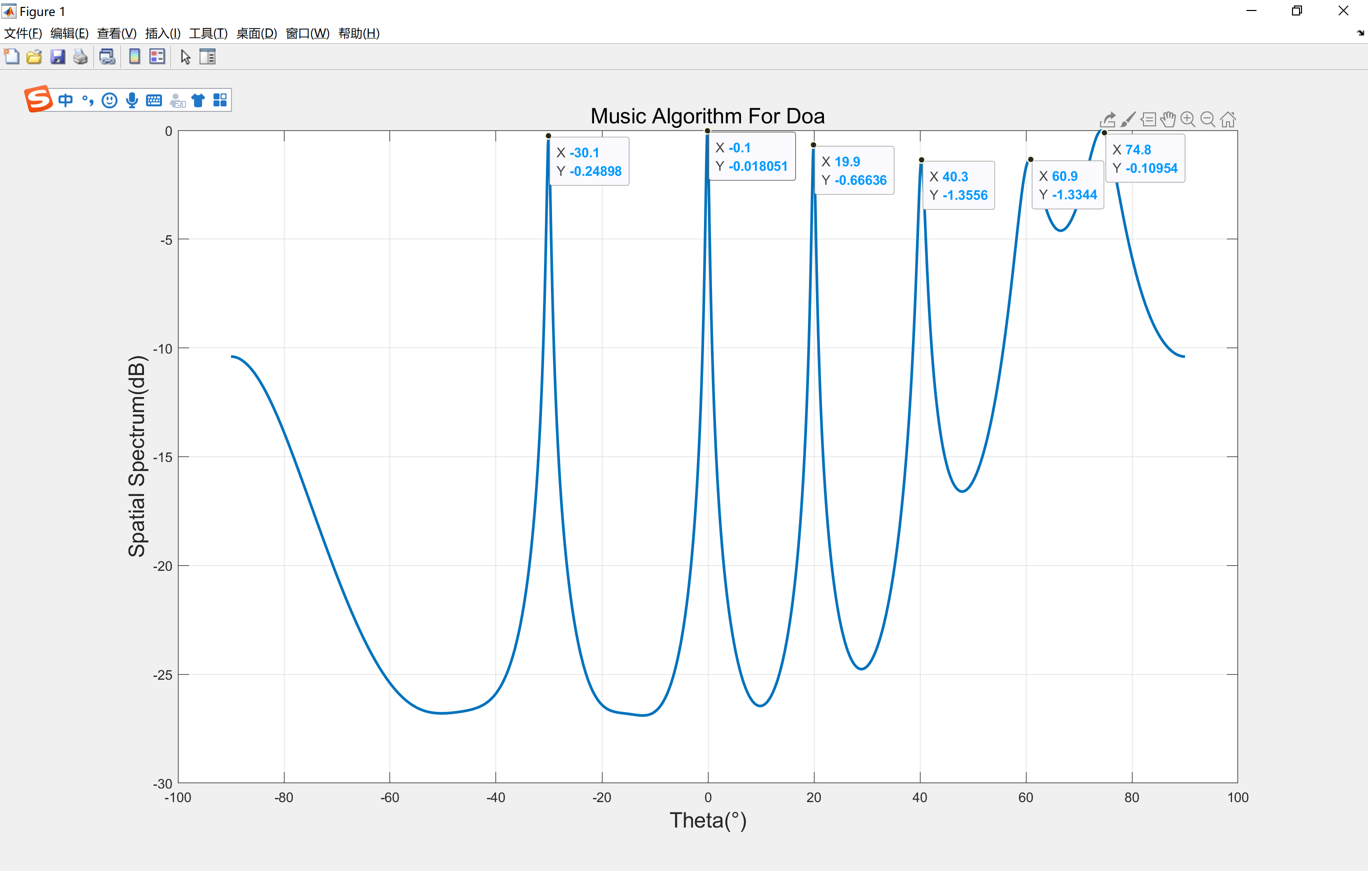
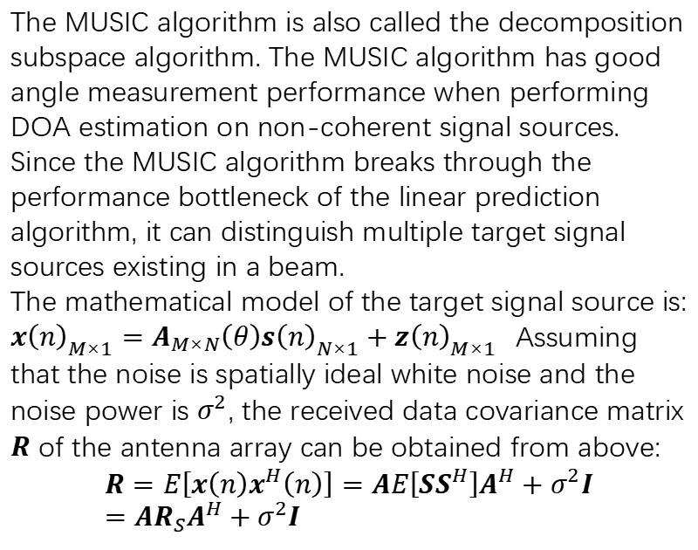
DOA Tech Background
MUSIC(Multiple Signal Classification)
The MUSIC algorithm is also called the decomposition subspace algorithm. The MUSIC algorithm has good angle measurement performance when performing DOA estimation on non-coherent signal sources. Since the MUSIC algorithm breaks through the performance bottleneck of the linear prediction algorithm, it can distinguish multiple target signal sources existing in a beam.
The mathematical model of the target signal source is:
$x{\left(n\right)}_{M×1}=A_{M×N}\left(θ\right)s{\left(n\right)}_{N×1}+z{\left(n\right)}_{M×1}$Assuming that the noise is spatially ideal white noise and the noise power is $σ^{2}$, the received data covariance matrix $R$ of the antenna array can be obtained from above:
$$R=E\left[x\left(n\right)x^{H}\left(n\right)\right]=AE\left[SS^{H}\right]A^{H}+σ^{2}I=AR_{S}A^{H}+σ^{2}I$$
Matlab simulation for the music algorithm

Slide 9
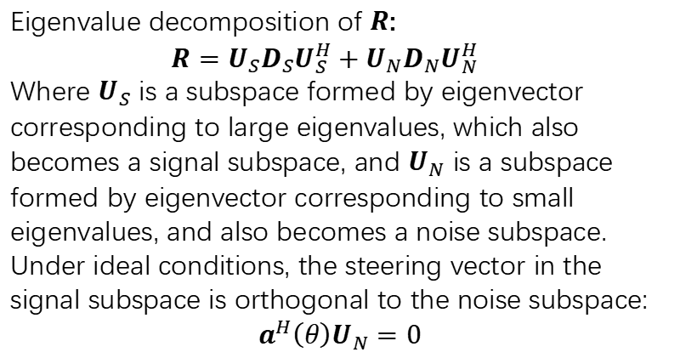
DOA Tech Background
MUSIC(Multiple Signal Classification)
Eigenvalue decomposition of $R$:
$$R=U_{S}D_{S}U_{S}^{H}+U_{N}D_{N}U_{N}^{H}$$
Where $U_{S}$ is a subspace formed by eigenvector corresponding to large eigenvalues, which also becomes a signal subspace, and $U_{N}$ is a subspace formed by eigenvector corresponding to small eigenvalues, and also becomes a noise subspace. Under ideal conditions, the steering vector in the signal subspace is orthogonal to the noise subspace:
$$a^{H}\left(θ\right)U_{N}=0$$
Matlab simulation for the music algorithm

Slide 10
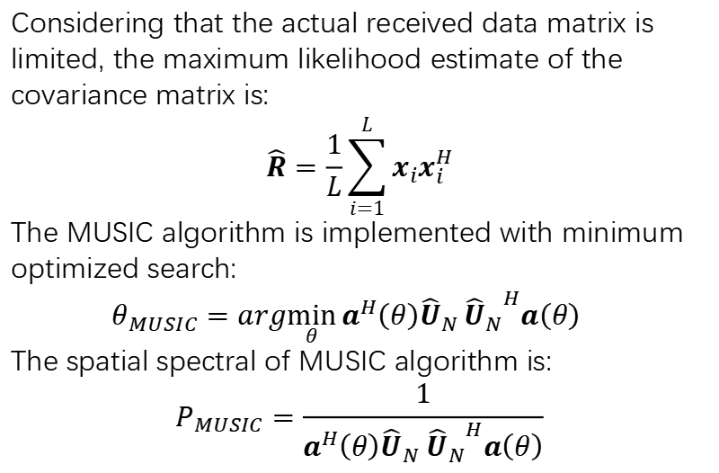
DOA Tech Background
MUSIC(Multiple Signal Classification)
Considering that the actual received data matrix is limited, the maximum likelihood estimate of the covariance matrix is:
$$\hat{R}=\frac{1}{L}\sum_{i=1}^{L}{x_{i}x_{i}^{H}}$$
The MUSIC algorithm is implemented with minimum optimized search:
$$θ_{MUSIC}=arg\min_{θ}{a^{H}\left(θ\right){\hat{U}}_{N}}{{\hat{U}}_{N}}^{H}a\left(θ\right)$$
The spatial spectral of MUSIC algorithm is:
$$P_{MUSIC}=\frac{1}{a^{H}\left(θ\right){\hat{U}}_{N} {{\hat{U}}_{N}}^{H}a\left(θ\right)}$$
Matlab simulation for the music algorithm

Slide 11
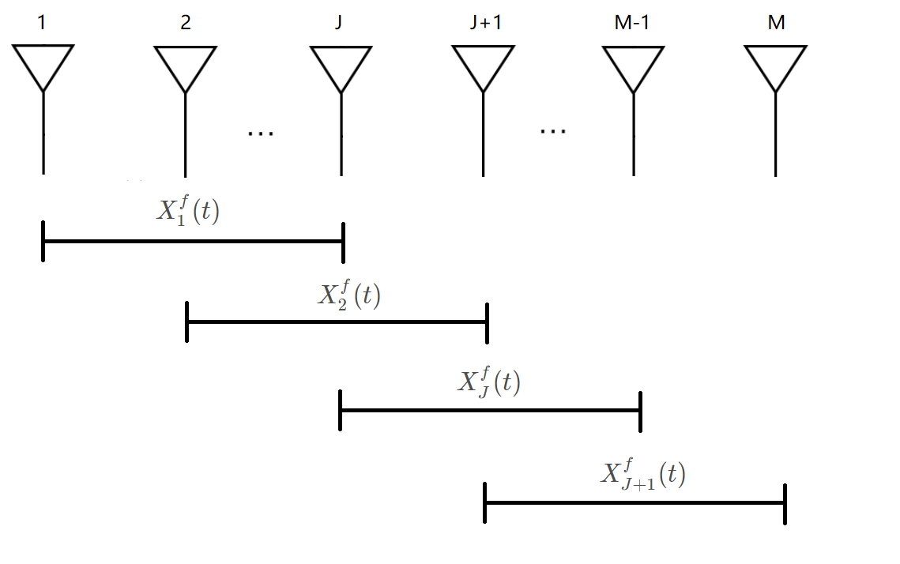
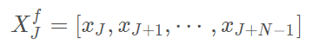
DOA Tech Background
Forward spatial smoothing algorithm
As shown in the figure above, we evenly divide the M-element array into L sub-arrays, and each sub-array has N=M-L+1 array elements. Taking the leftmost sub-array as the reference array, define the received data of the J-th sub-array as:
Then the covariance matrix (also called the spatial smoothing matrix) of the received data of the J-th subarray can be expressed as

Slide 12
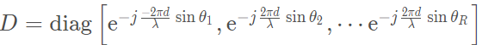
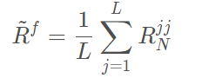
DOA Tech Background
Forward spatial smoothing algorithm
among them,
A1 is the flow matrix of the first sub-array, that is, the reference array.
Therefore, the covariance matrix after forward space smoothing can be obtained by averaging the covariance matrix of each sub-matrix.
Using forward spatial smoothing covariance matrix and MUSIC algorithm, the orientation of multiple coherent signals can be distinguished. It can be proved that this method can detect up to M/2 coherent signals.

Slide 13
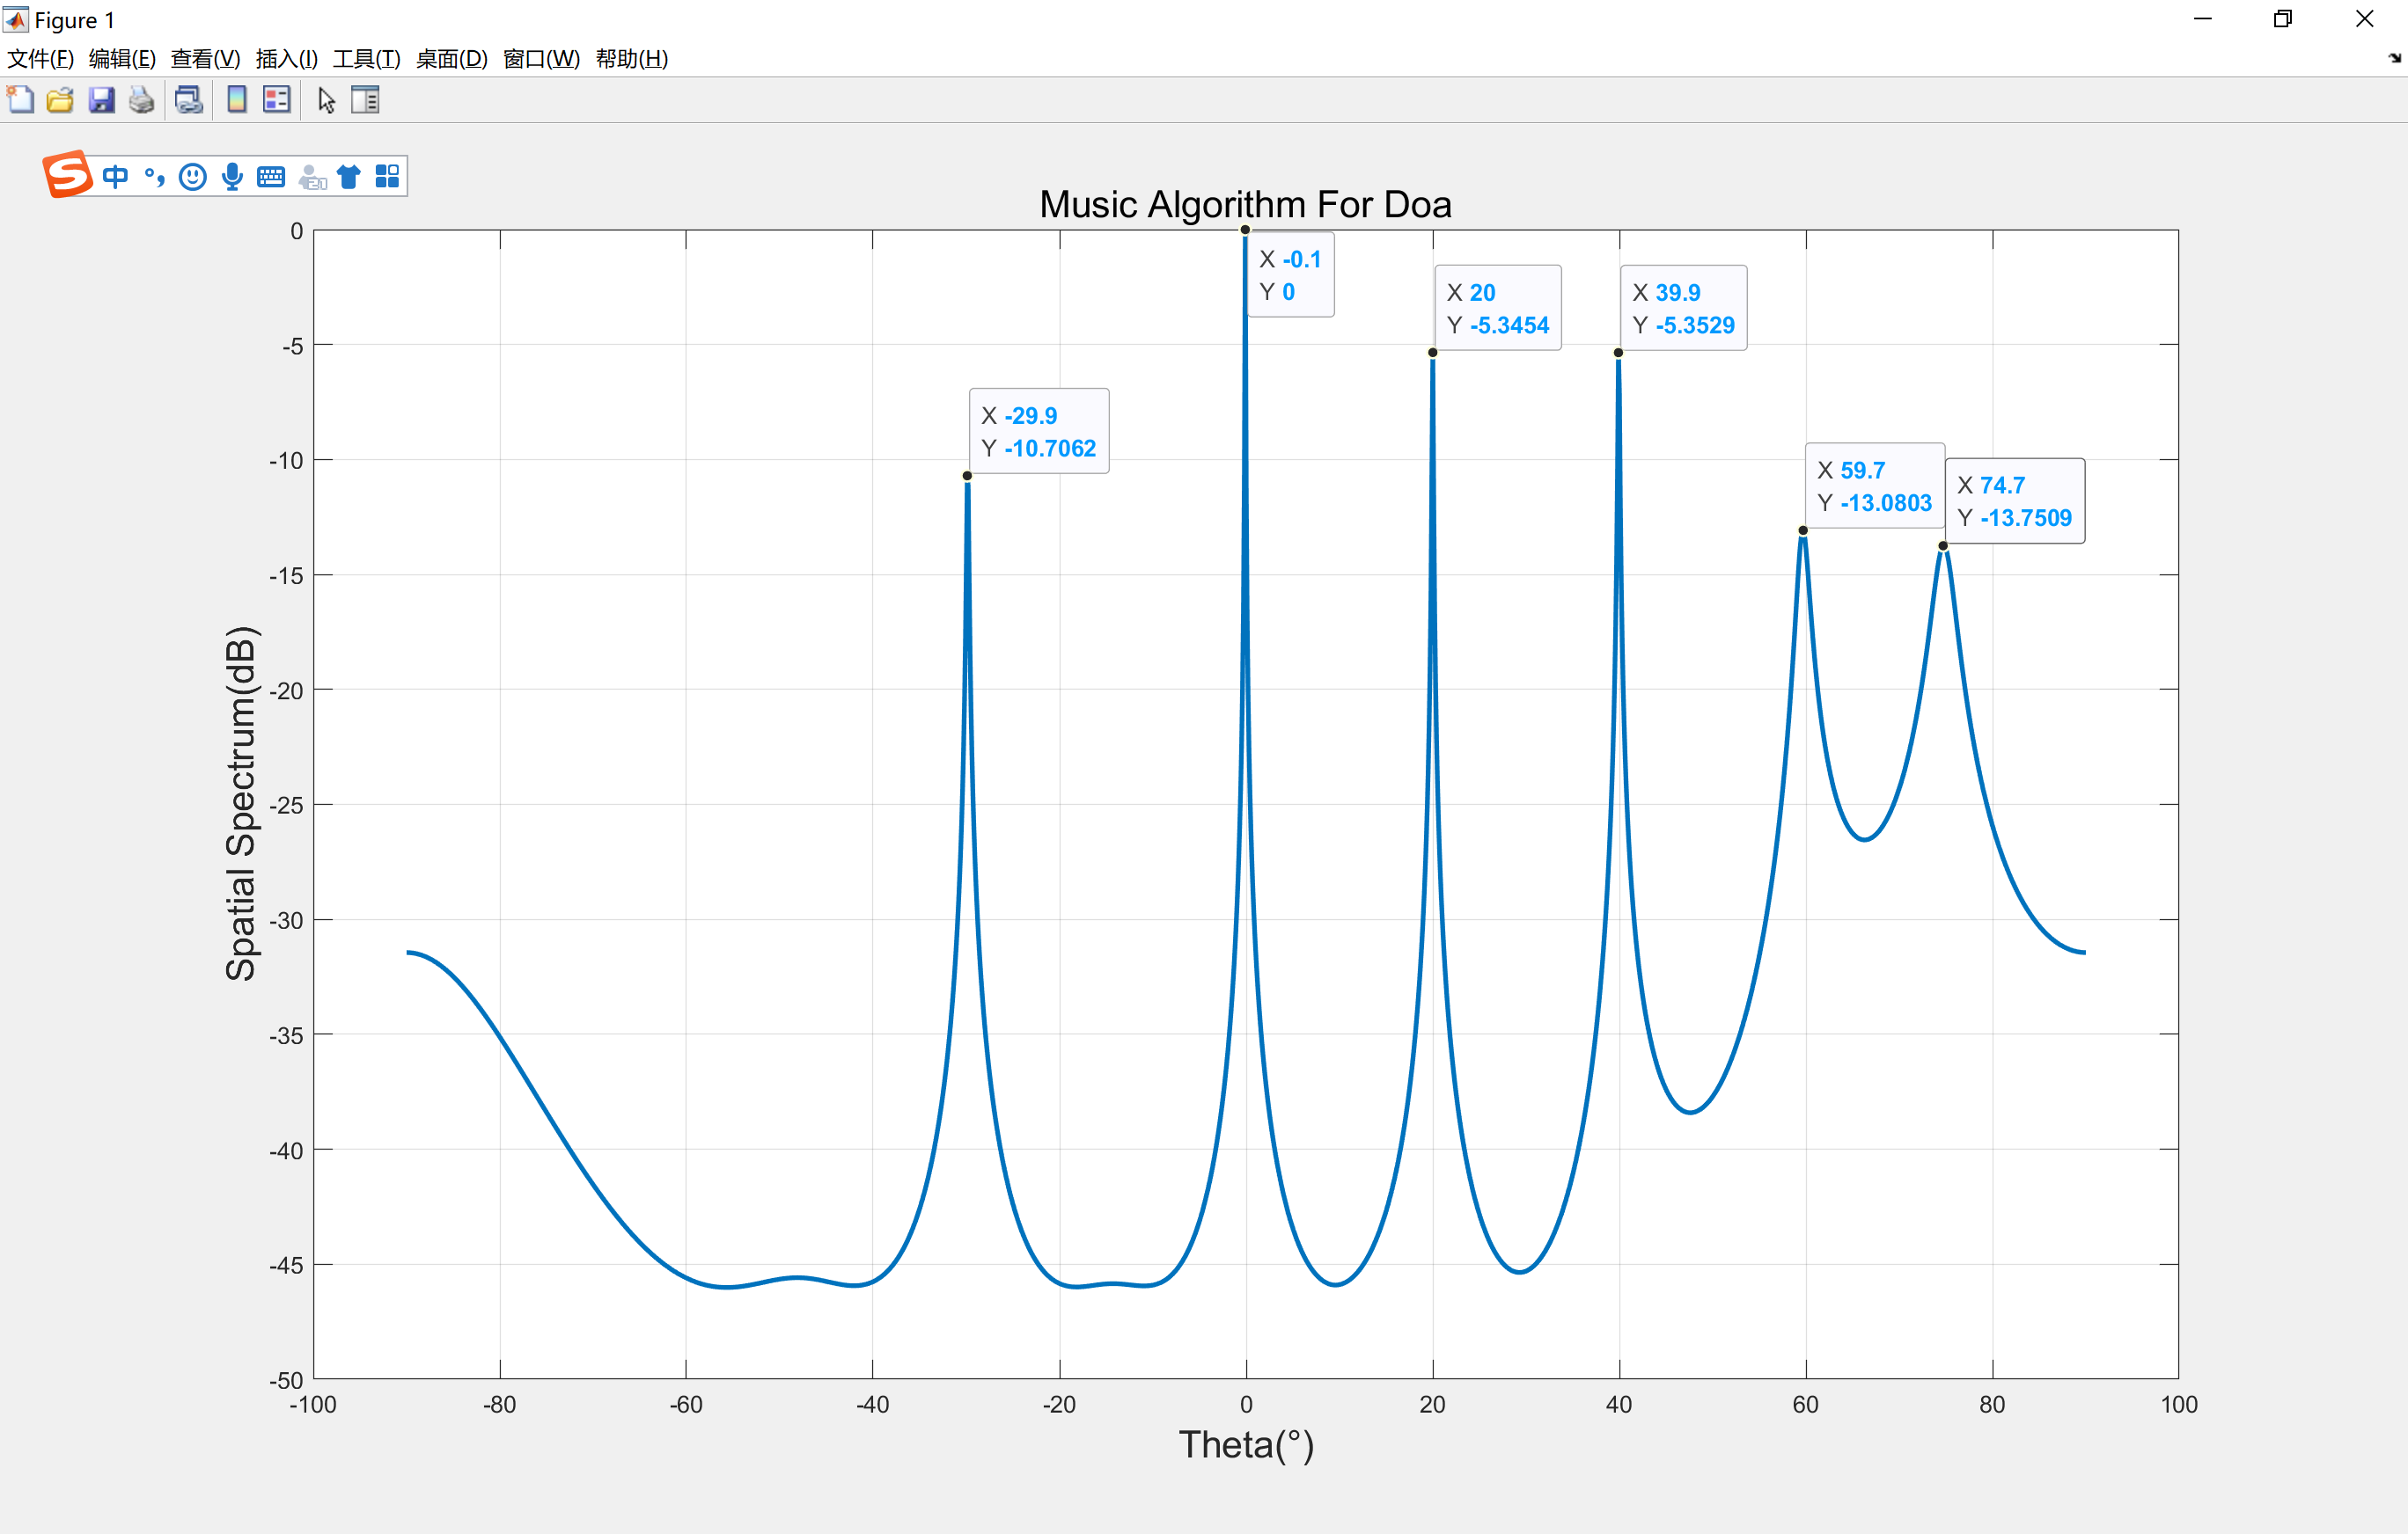
DOA Tech Background
Forward spatial smoothing algorithm
It can be seen that when the 6 incident signals are uniformly coherent, the MUSIC algorithm based on forward smoothing can better estimate the DOA, but there are still estimation accuracy problems, such as the signal with a true incident angle of 75° The bearing is estimated to be 74.2°.

Slide 14
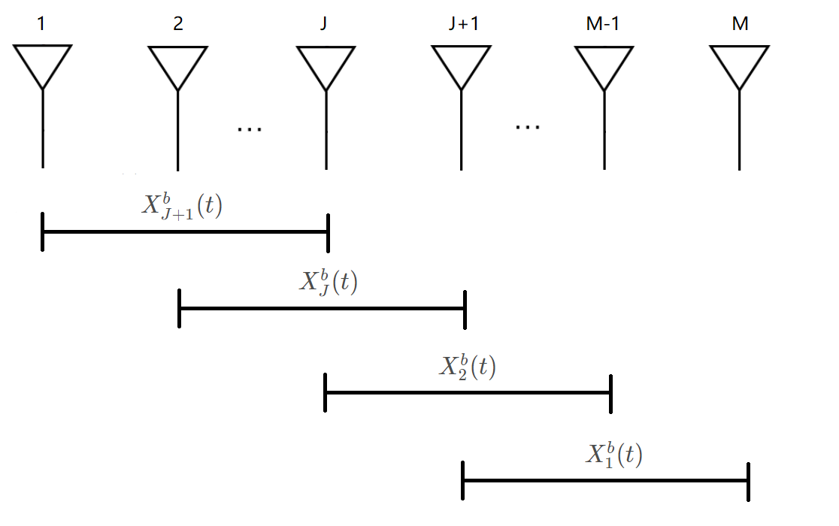
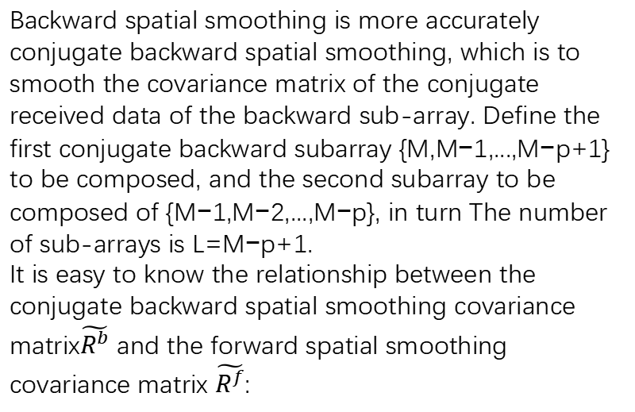
DOA Tech Background
Backward spatial smoothing algorithm
Backward spatial smoothing is more accurately conjugate backward spatial smoothing, which is to smooth the covariance matrix of the conjugate received data of the backward sub-array. Define the first conjugate backward subarray {M,M−1,...,M−p+1} to be composed, and the second subarray to be composed of {M−1,M−2,...,M−p}, in turn The number of sub-arrays is L=M−p+1.
It is easy to know the relationship between the conjugate backward spatial smoothing covariance matrix$\tilde{R^{b}}$ and the forward spatial smoothing covariance matrix $\tilde{R^{f}}$:

Slide 15
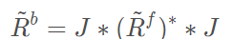
DOA Tech Background
Backward spatial smoothing algorithm
Using backward spatial smoothing covariance matrix and MUSIC algorithm can also distinguish the orientation of multiple coherent signals. It can be proved that the method can detect M/2 coherent signals at most.

Slide 16
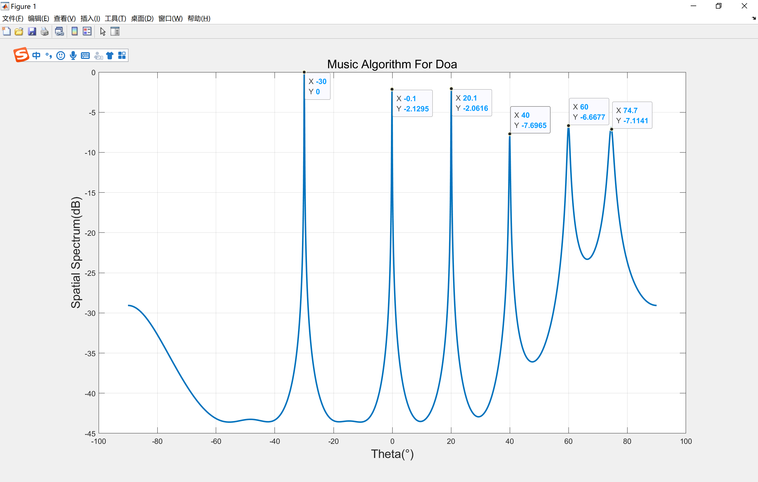
DOA Tech Background
Forward spatial smoothing algorithm
It can be seen that when the six incident signals are uniformly coherent, the MUSIC algorithm based on backward spatial smoothing can better estimate its DOA, and the estimation accuracy is higher.

Slide 17
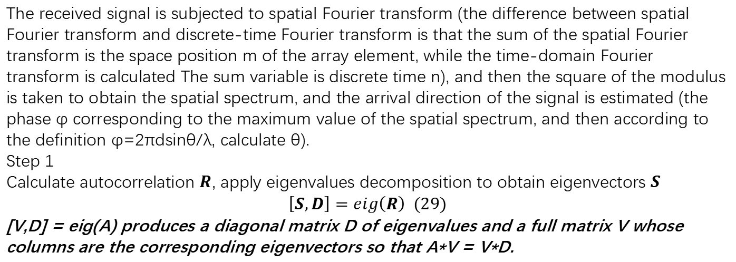
DOA Tech Background
ESPRIT(Estimating Signal Parameters Via Rotational Invariance Techniques)
The received signal is subjected to spatial Fourier transform (the difference between spatial Fourier transform and discrete-time Fourier transform is that the sum of the spatial Fourier transform is the space position m of the array element, while the time-domain Fourier transform is calculated The sum variable is discrete time n), and then the square of the modulus is taken to obtain the spatial spectrum, and the arrival direction of the signal is estimated (the phase φ corresponding to the maximum value of the spatial spectrum, and then according to the definition φ=2πdsinθ/λ, calculate θ).
Step 1
Calculate autocorrelation $R$, apply eigenvalues decomposition to obtain eigenvectors $S$
$$\left[S,D\right]=eig\left(R\right) (29)$$
[V,D] = eig(A) produces a diagonal matrix D of eigenvalues and a full matrix V whose columns are the corresponding eigenvectors so that A*V = V*D.

Slide 18
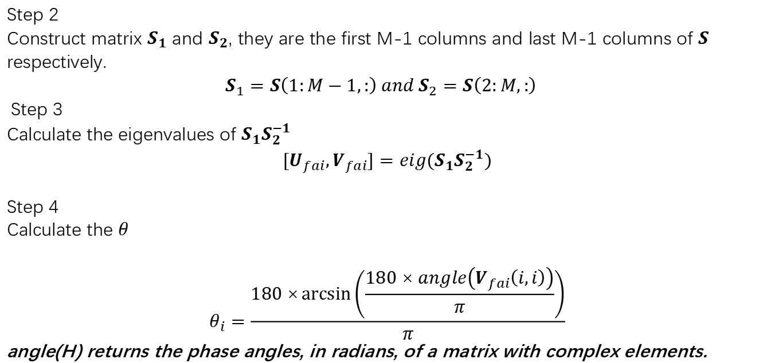
DOA Tech Background
ESPRIT(Estimating Signal Parameters Via Rotational Invariance Techniques)
Step 2
Construct matrix $S_{1}$ and $S_{2}$, they are the first M-1 columns and last M-1 columns of $S$ respectively.
$$S_{1}=S\left(1:M−1,:\right) and S_{2}=S\left(2:M,:\right)$$
Step 3
Calculate the eigenvalues of $S_{1}S_{2}^{−1}$
$$[U_{fai},V_{fai}]=eig(S_{1}S_{2}^{−1})$$
Step 4
Calculate the $θ$
$$θ_{i}=\frac{180×\arcsin\left(\frac{180×angle\left(V_{fai}\left(i,i\right)\right)}{π}\right)}{π}$$
angle(H) returns the phase angles, in radians, of a matrix with complex elements.

Slide 19
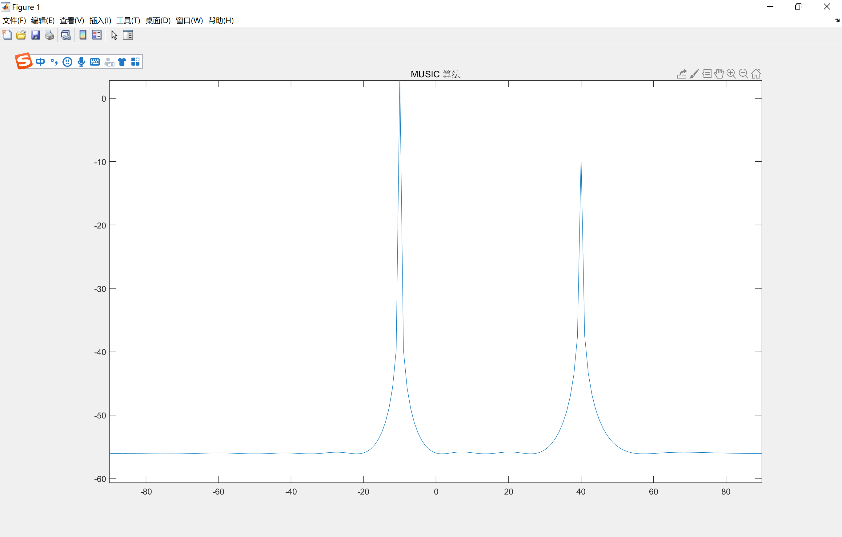
DOA Tech Background
ESPRIT(Estimating Signal Parameters Via Rotational Invariance Techniques)
The three pictures from top to bottom are simulation images of the MUSIC algorithm, MVDR algorithm, and F-SAPES algorithm. Because it is a preliminary exploration of the algorithm, we have a certain understanding of the principles and operation process of the three algorithms, but there is no complete system for the analysis process of the effect of the three algorithms.

Slide 20
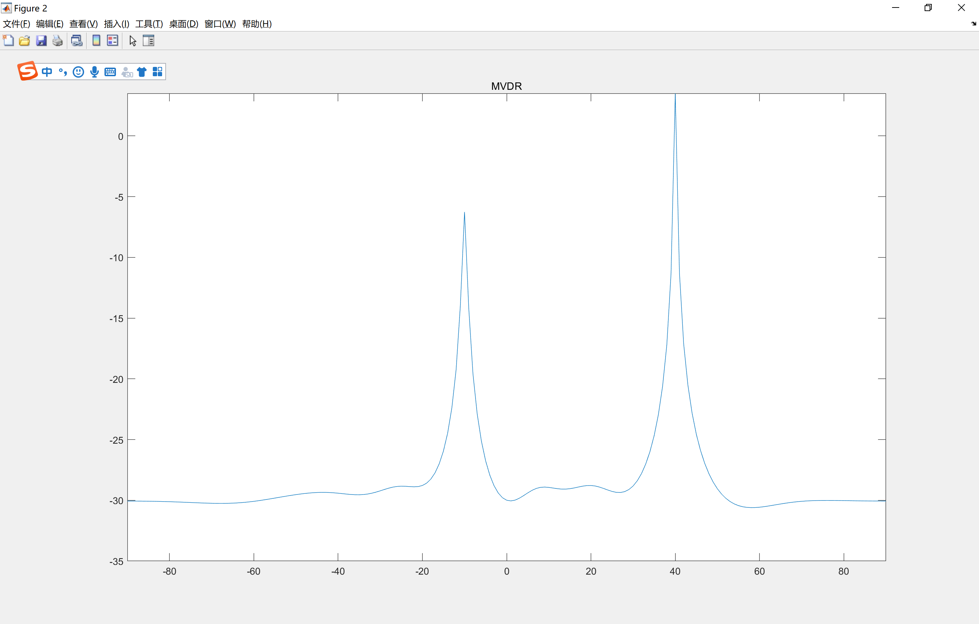
DOA Tech Background
ESPRIT(Estimating Signal Parameters Via Rotational Invariance Techniques)
We have simulated the results of the three algorithms. With a certain understanding, a certain analysis was carried out. However, our overall grasp of the three algorithms is not yet in place, there are still certain deficiencies in the construction of the knowledge system, and there may still be certain imperfections in the principle analysis.

Slide 21
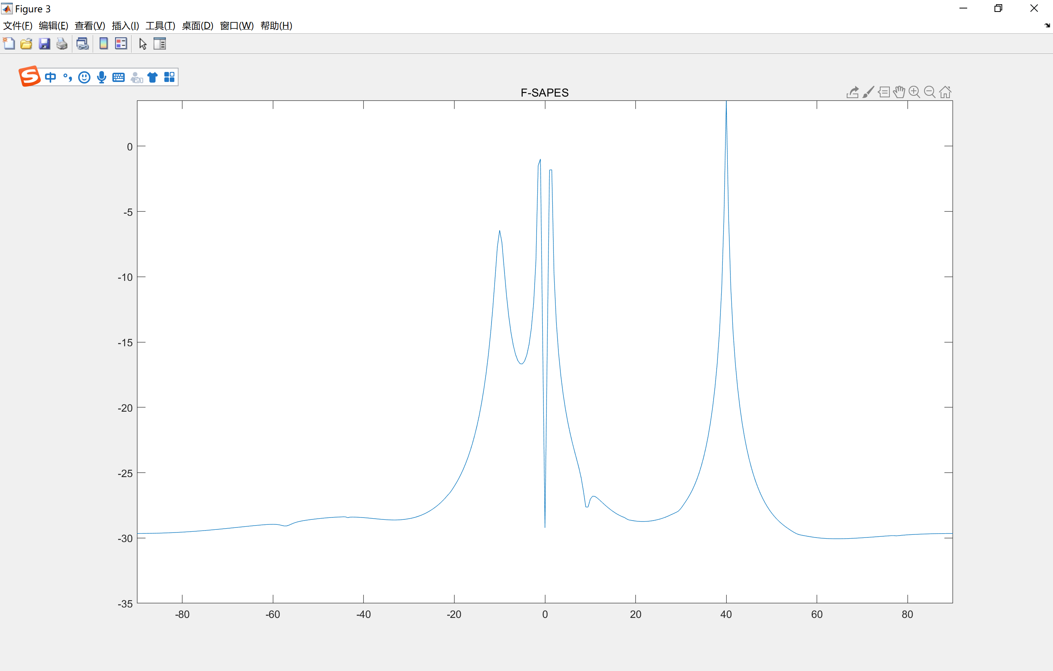
DOA Tech Background
ESPRIT(Estimating Signal Parameters Via Rotational Invariance Techniques)
Therefore, our analysis of the three algorithms will not be presented in the report. We will focus on this aspect and comprehensively improve it in subsequent experiments and reports.

Slide 22
Second
DOA Algorithms

Slide 23
DOA Algorithms
Delay-Sum Beamformer
Traditional:
CBF/Bartlett BF
Capon LMS/Capon BF/MVDR
Root MUSIC
MUSIC
Decoherence MUSIC
DOA
Subspace:
Beamspace-Base MUSIC
ESPRIT
TAM
Deterministic ML
LS-ESPRIT
ML:
TLS-ESPRIT
Stochastic ML
https://wenku.baidu.com/view/eece77f8c67da26925c52cc58bd63186bceb9201.html

Slide 24
DOA Algorithms
We focus on the MUSIC algorithms
Subspace:
Root MUSIC
MUSIC
Decoherence MUSIC
Beamspace-Base MUSIC

Slide 25
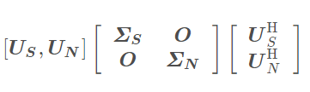
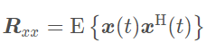
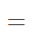
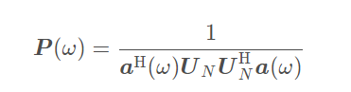
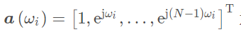
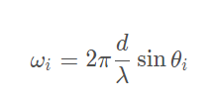
DOA Algorithms
MUSIC
利用了信号子空间和噪音子空间相互正交的性质
Multiple Signal Classification
多信号分类算法
https://blog.csdn.net/qq_36583373/article/details/109333087

Slide 26
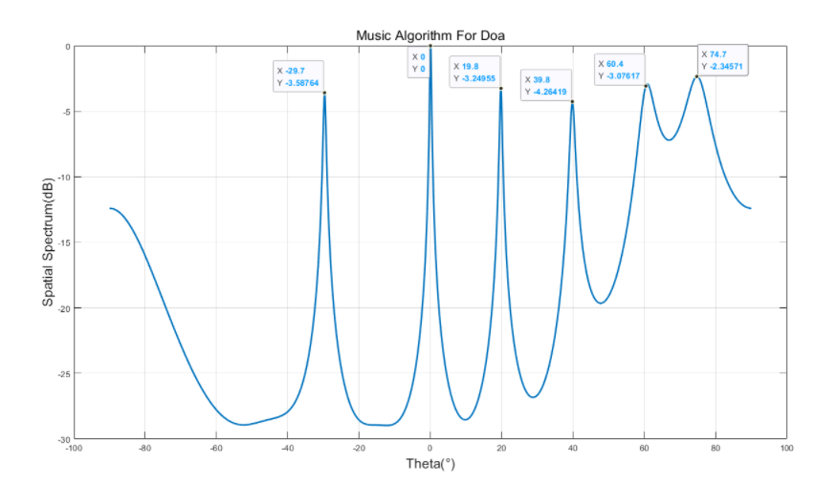
DOA Algorithms
通过改变空间参数也就是theta，进行谱峰搜索，确定信号方向
https://blog.csdn.net/qq_36583373/article/details/109333087

Slide 27
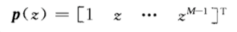
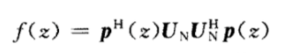
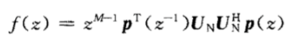
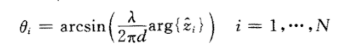
DOA Algorithms
这里的z就是前面的信号空间特征值对应的特征向量
Root MUSIC
为了降低计算复杂度，省去共轭z项，将式子改写成
直接求根，从而计算出theta值
https://blog.csdn.net/weixin_38452468/article/details/73274627

Slide 28
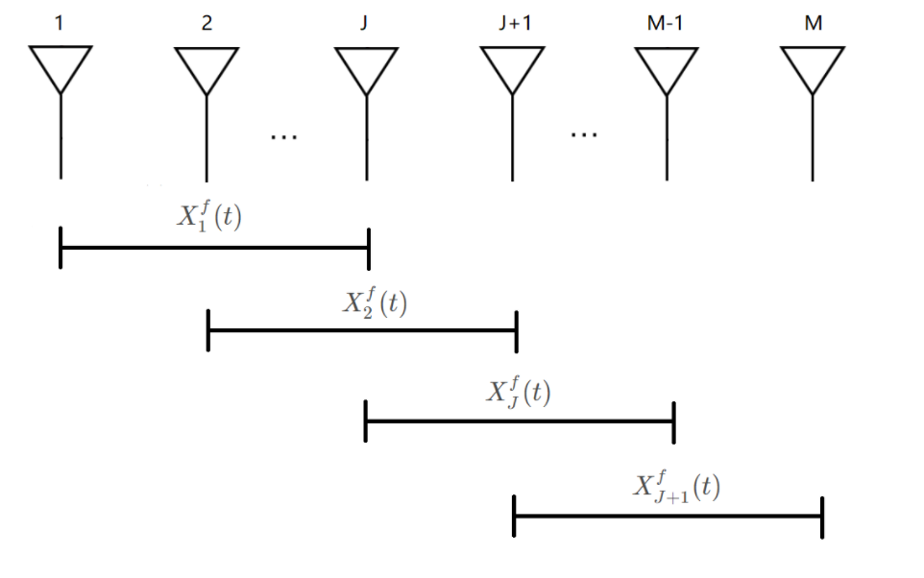
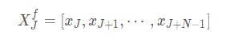
DOA Algorithms
前后向空间平滑算法
We focus on the MUSIC algorithms
Decoherence MUSIC
解相干的MUSIC算法
传统算法在处理相干信号的时候DOA结果并不理想
https://blog.csdn.net/qq_36583373/article/details/109364878

Slide 29
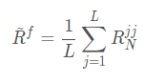
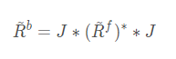
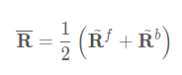
DOA Algorithms
前后向空间平滑算法
We focus on the MUSIC algorithms
Decoherence MUSIC
解相干的MUSIC算法
传统算法在处理相干信号的时候DOA结果并不理想
https://blog.csdn.net/qq_36583373/article/details/109364878

Slide 30
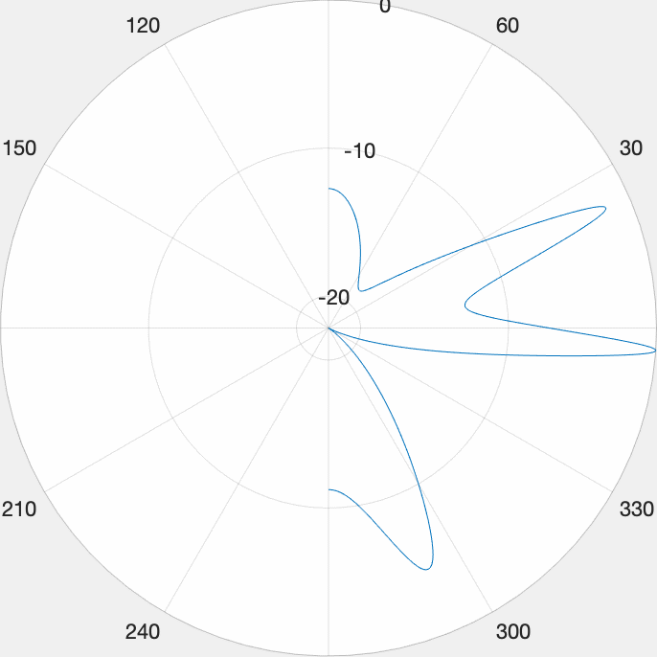
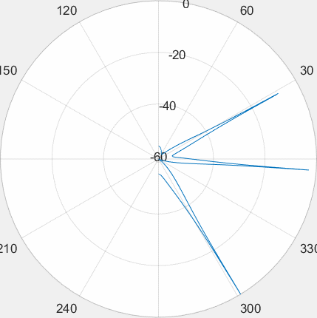
DOA Algorithms
MUSIC
Decoherence MUSIC
空间谱搜索
前后向空间平滑算法

Slide 31
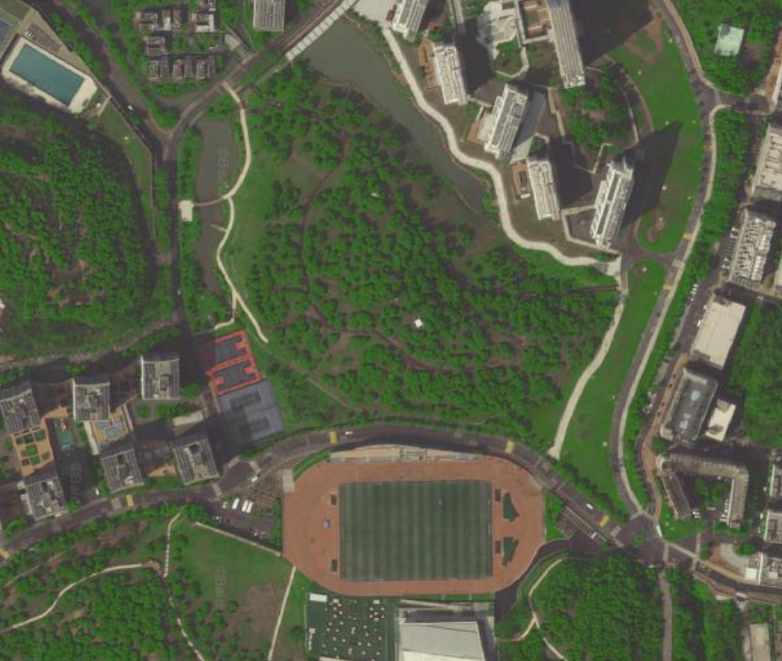
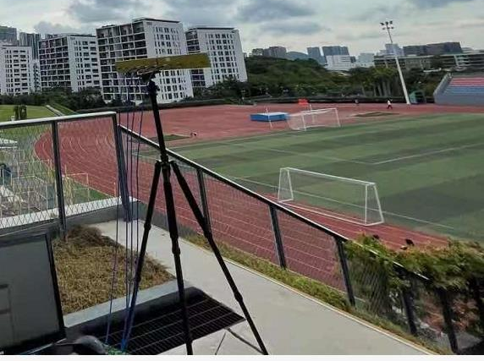
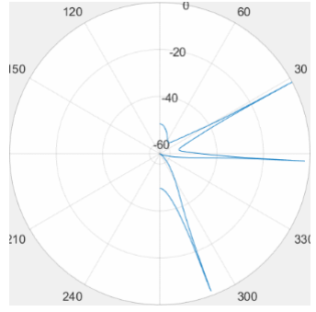
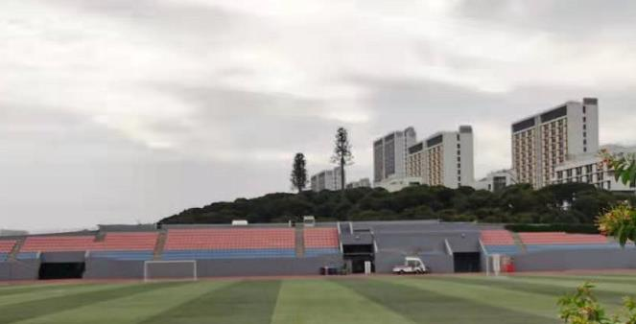
DOA Algorithms
新生宿舍
基站大概位置
专家公寓
慧园
接收机位置

Slide 32
Third
Range-Doppler Calculation

Slide 33
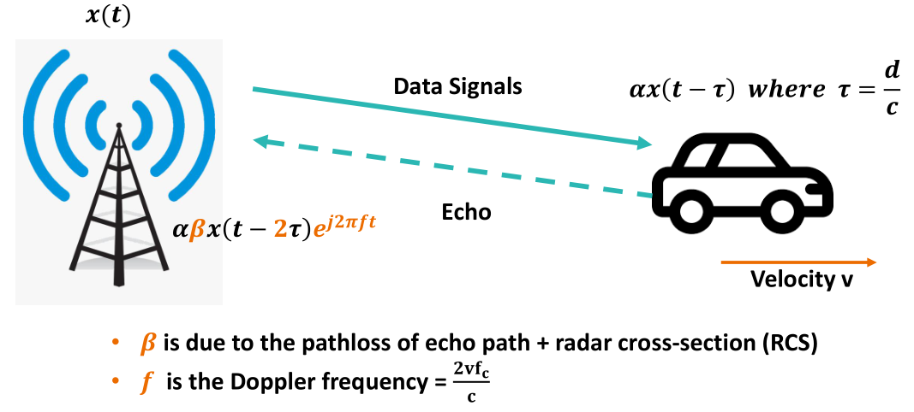
Range-Doppler Calculation
From Rui Wang’s Lecture

Slide 34
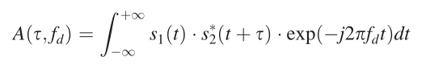
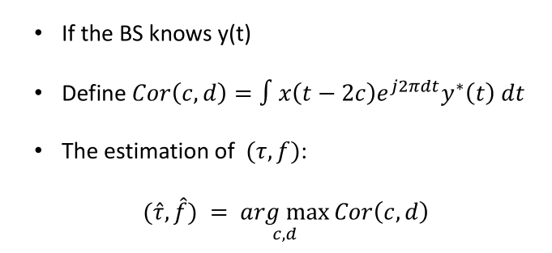
Range-Doppler Calculation
Ambiguity Function

Slide 35


Range-Doppler Calculation

Slide 36
Range-Doppler Calculation
Deg = -20
Deg = 30

Slide 37
Range-Doppler Calculation
Deg = 29
Deg = 30
Deg = 31

Slide 38


Range-Doppler Calculation
Ambiguity Function

Slide 39
Experience Detail
Signal sampling
Clock synchronization
Digital mixing
Low pass filter
Beamforming
Direct wave, clutter elimination
Find Ambiguity Value
RD graph

Slide 40
Fourth
Experience Detail

Slide 41


Experience Detail

Slide 42


Experience Detail
Side-by-side array antenna

Slide 43

Experience Detail
Circular array antenna

Slide 44


Experience Detail
Side-by-side array antenna

Slide 45


Experience Detail
Circular array antenna

Slide 46

Experience Detail

Slide 47


Experience Detail

Slide 48


Experience Detail

Slide 49

Experience Detail
Signal source detection
In the experiment, we chose two signal sources, one is the signal source that Professor Wu gave us that can switch the frequency, and the other is the fixed signal source in the school, which is the communication base station. Here we try to choose different generations The communication frequency of the operator can be detected. From the public information, we can find the communication frequency used by the operator.

Slide 50

Experience Detail
Signal source detection
The experimental location we chose is Songhe Stadium, where the distance from the base station signal source is relatively moderate, the venue is also wide enough, and the multipath effect is relatively weak.

Slide 51


Experience Detail
experiment procedure

Slide 52


Experience Detail
experiment procedure

Slide 53


Experience Detail
experiment procedure

Slide 54


Experience Detail
experiment procedure

Slide 55


Experience Detail
experiment procedure

Slide 56


Experience Detail
experiment procedure

Slide 57


Experience Detail
experiment procedure

Slide 58


Experience Detail
experiment procedure

Slide 59


Experience Detail
experiment procedure

Slide 60
Experiment Detail
信号采样
时钟同步
数字混频
低通滤波
波束赋形
直达波、杂波消除
求Ambiguity Value
作RD图

Slide 61

Experience Detail
元哥哥由于我不知道这些个流程的你的想法，我把这里标出来你来做这一点吧，做的时候就在这张ppt上做就可以，把图片与对话框删去。

Slide 62
Fifth
Conclusion

Slide 63
Conclusion
Programming ability
Experimental ability
Main gains
Teamwork
Use tools and read literature
Notes:
全球主要软体机器人制造商包括Cyberdyne、Soft Robotics、Ekso Bionics、Holdings、ReWalk Robotics RightHand Robotics Parker Hannifin北京软体机器人公司。
Cyber是全球最大的企业，北软是国内行业的龙头

Slide 64
Conclusion
The internal noise source cannot be turned on, causing the device to fail to synchronize
The experimental site is not ideal, so it is subject to some interference
The temperature of the experimental site is not ideal, resulting in high temperature of the experimental equipment
Notes:
全球主要软体机器人制造商包括Cyberdyne、Soft Robotics、Ekso Bionics、Holdings、ReWalk Robotics RightHand Robotics Parker Hannifin北京软体机器人公司。
Cyber是全球最大的企业，北软是国内行业的龙头

Slide 65
Reference
[1] Giordani, M., M. Polese, A. Roy, D. Castor, and M. Zorzi. "A tutorial on beam management for 3GPP NR at mmWave frequencies." IEEE Comm. Surveys & Tutorials, vol. 21, No. 1, Q1 2019.
[2] 3GPP TR 38.802 V14.2.0 6.1.6.1
[3] https://ww2.mathworks.cn/help/5g/ug/nr-ssb-beam-sweeping.html

Slide 66
Thanks for
Watching!

